Slide 1
Presentation 2
A French Company

Slide 2

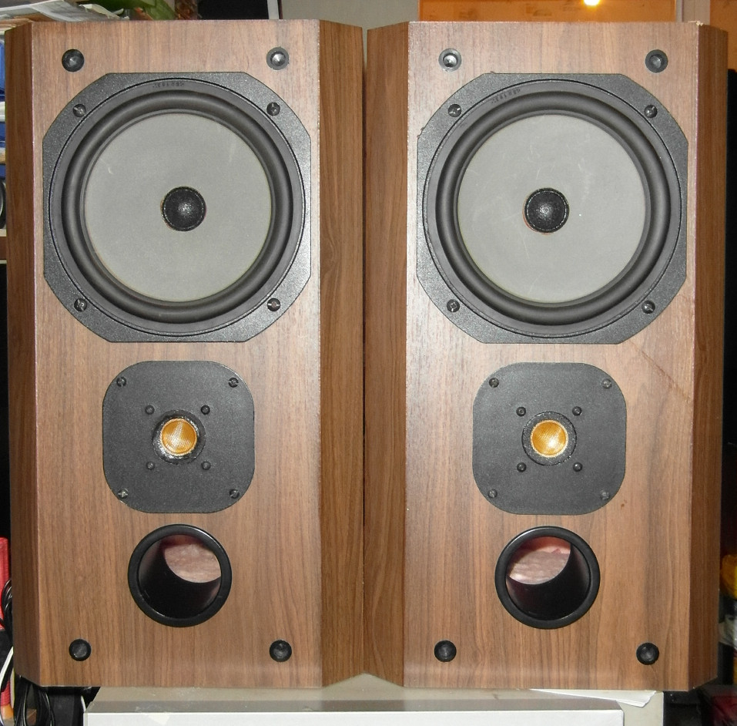
In St-Etienne since 1979
Speaker developpement, innovation and manufacture
Today : European leader in Hi-Fi audio
Very High-end branding

Slide 3
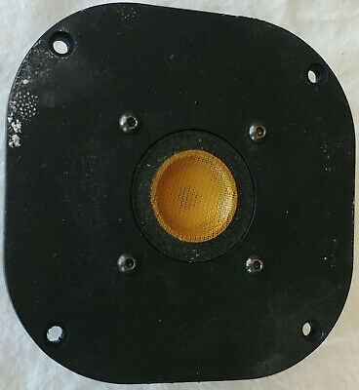
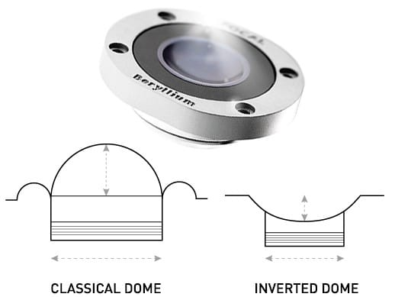
Inverted Dome Tweeter

Slide 4
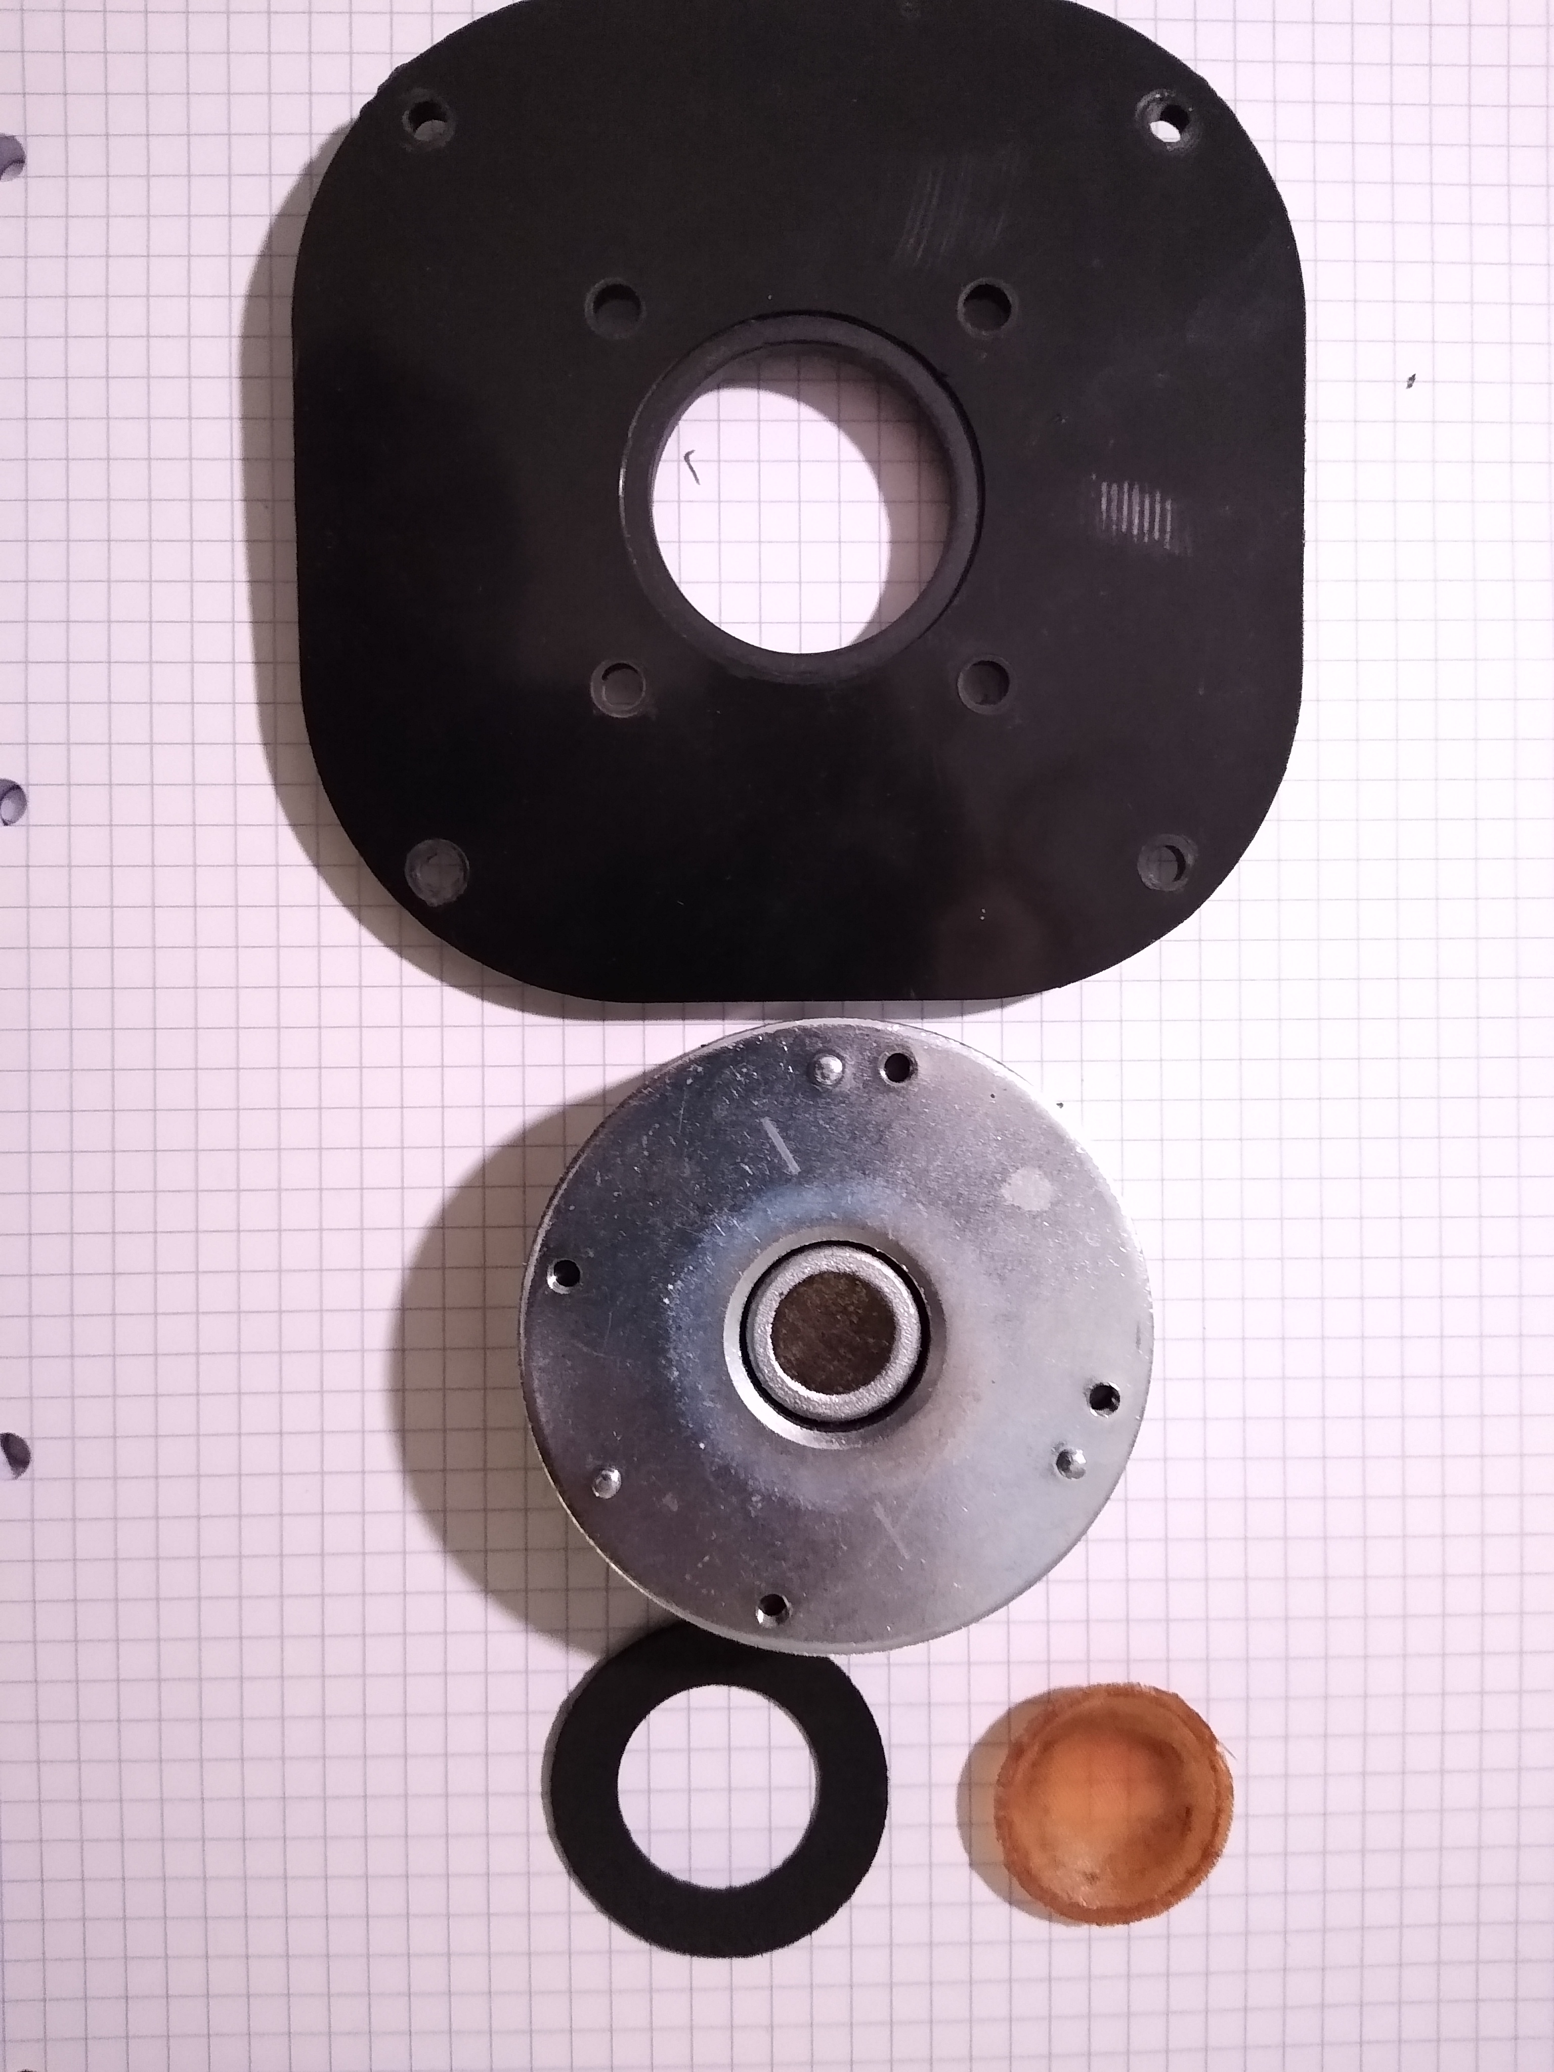
Parts
- Support
- Motor
- Suspension
- Membrane (Dome)
- Voice Coil

Slide 5
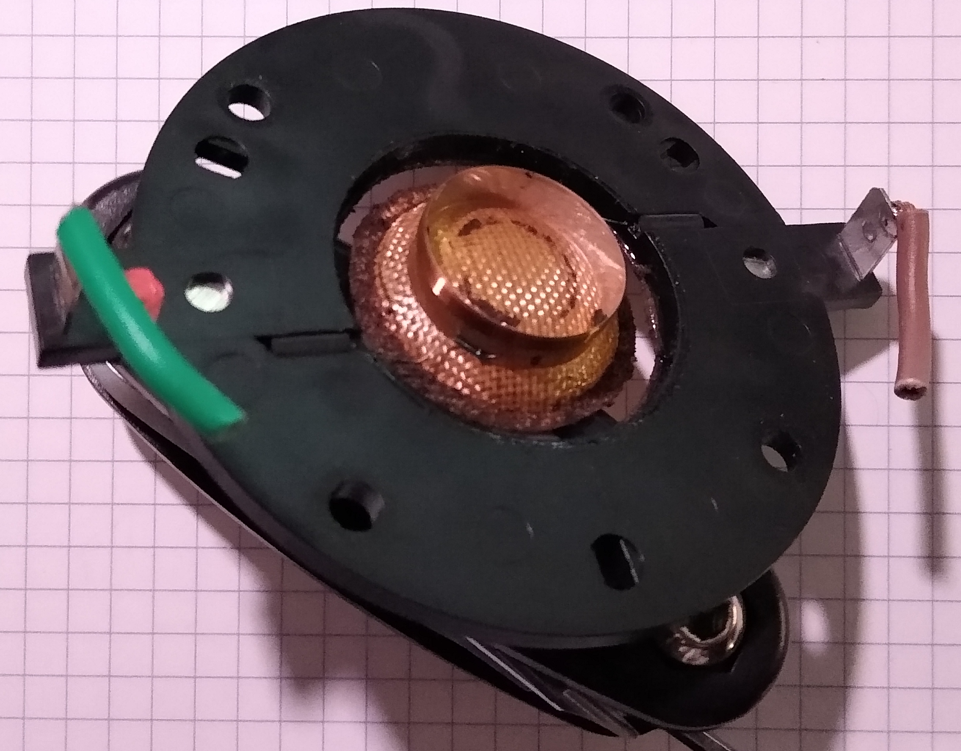
Parts

Slide 6
Conclusion
One of the most succesful brand thanks to their innovations and their will to perfectly reproduce the music.
LISTEN BEYOND

